Slide 1


Intelligent Customer Feedback Analysis and Sentiment Classification
Leveraging Machine Learning and NLP for Insights by Group 3
Imanul Hoque
Pratishtha Sharma
Rohan Singh
Ujjwal Kumar

Slide 2




Meet the Team
Imanul Hoque
Pratishtha Sharma
Rohan Singh
Ujjwal Kumar

Slide 3
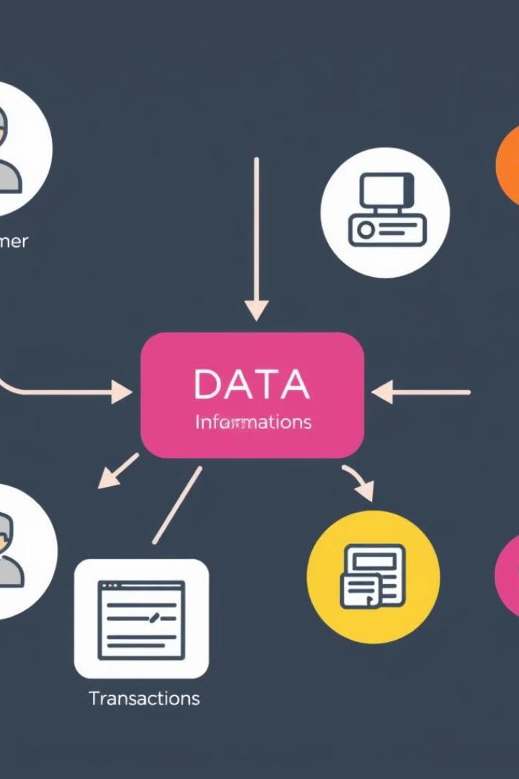


Our Data
Source
The dataset from hugging face based on beauty products that comprises customer feedback data, capturing detailed records
Features
The dataset includes essential features like 'rating', 'title', 'text', ''user_id', 'timestamp', 'helpful_vote', 'verified_purchase'
Objective
Analyzing data helps us understand customer satisfaction over products and respond to issues faster

Slide 4
Project Workflow
Data Exploration & Cleaning
1
Initial steps involve understanding the data, identifying missing values, and handling outliers.
2
Sentiment Analysis and Trend Analysis
Classify customer feedback as positive, negative, or neutral and Track sentiment over time to identify trends.
Topic Modeling
3
Identify the main topics or themes in customer feedback
4
Emotion Detection
Detect specific emotions (e.g., anger, joy, frustration) to prioritize high-impact feedback
Automatic Response Generation
5
Used template to Generate suggested responses for common issues or queries
Application Development
6
Building a user-friendly application for getting insights from user feedback

Slide 5
















Tools and Technologies
S

Slide 6

Text Preprocessing with NLP

Slide 7
Key Preprocessing Techniques Used
Remove Special Characters
Removed null and duplicate values
Convert to Lowercase
Eliminate symbols, punctuation, and other non-alphanumeric characters that can interfere with text analysis.
Discarded duplicated values and dropped null rows
Normalize text by converting all characters to lowercase, ensuring consistency across the dataset.
1
Tokenization
2
Stop Word Removal
Break text into individual words or tokens for further processing.
Eliminate common, high-frequency words that provide little semantic value.

Slide 8

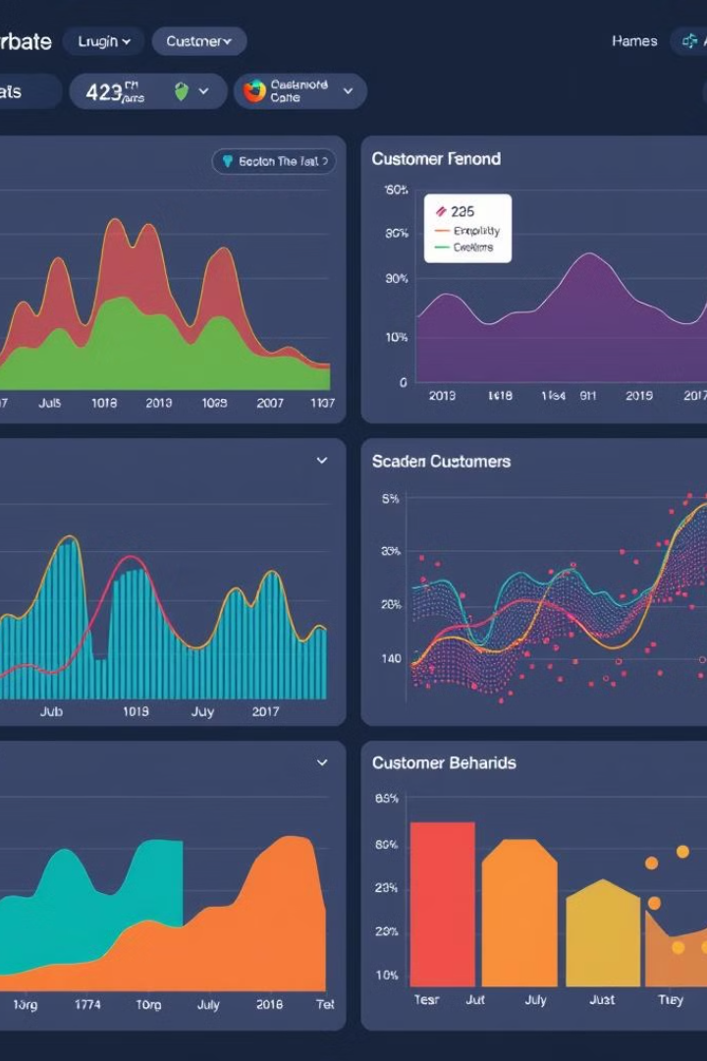
EDA of the Customer Review Data
This section provides an in-depth exploratory data analysis of customer review data, uncovering key insights and trends to drive business decisions.

Slide 9

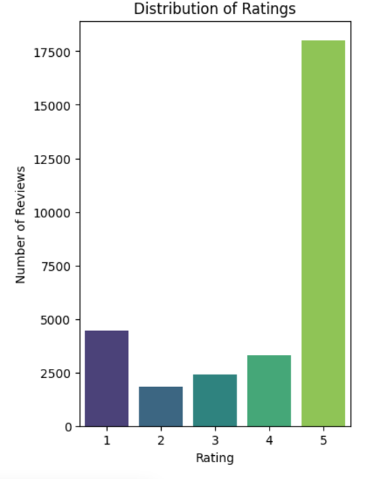
Rating Distribution
Rating Breakdown
The data shows a wide range of customer ratings, from 1-star to 5-star. Understanding this distribution is crucial for identifying areas for improvement
1
Positive Sentiment
2
Opportunities
The lower-rated reviews provide valuable feedback on areas that need attention, such as product issues or customer service concerns.
The majority of reviews are positive, with a high concentration of 5-star ratings. This indicates strong customer satisfaction overall.

Slide 10
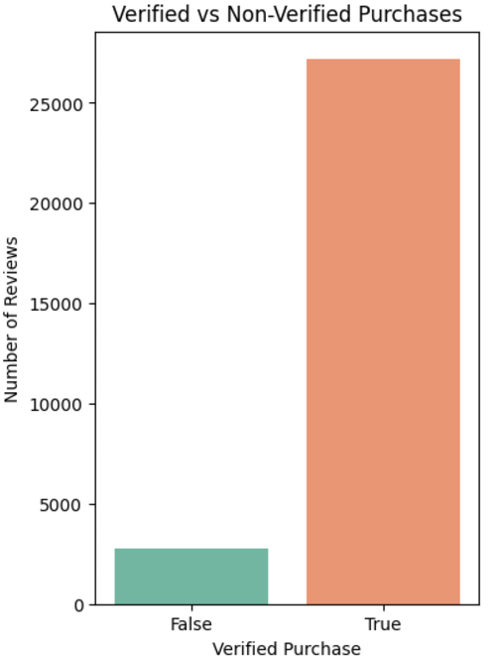
Verified vs. Unverified Purchases
Verified Purchases
Customers who have made verified purchases tend to provide more reliable and trustworthy feedback, as their reviews are tied to actual transactions.
Non-Verified Purchases
While non-verified reviews can still provide valuable insights, it's important to consider potential bias or lack of credibility in the feedback.

Slide 11
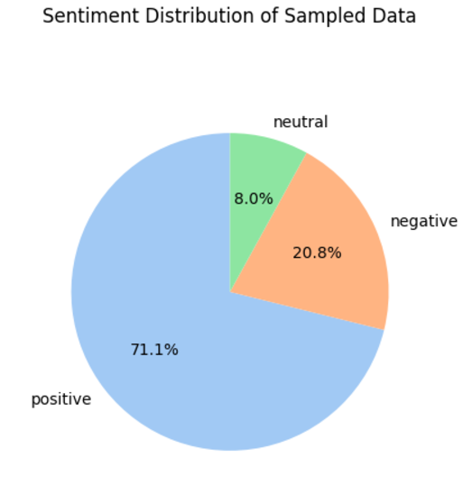
Sentiment Distribution
1
Positive Sentiment
2
Negative Sentiment
The majority of reviews express positive sentiment, indicating high customer satisfaction with the product or service.
Negative reviews provide valuable feedback on areas for improvement, such as product quality or customer support issues.
3
Neutral Sentiment
Actionable Insights
Neutral reviews may indicate areas that are not strongly positive or negative, but still warrant further investigation.
Understanding the sentiment distribution can guide strategic decision-making and help prioritize areas for improvement.

Slide 12
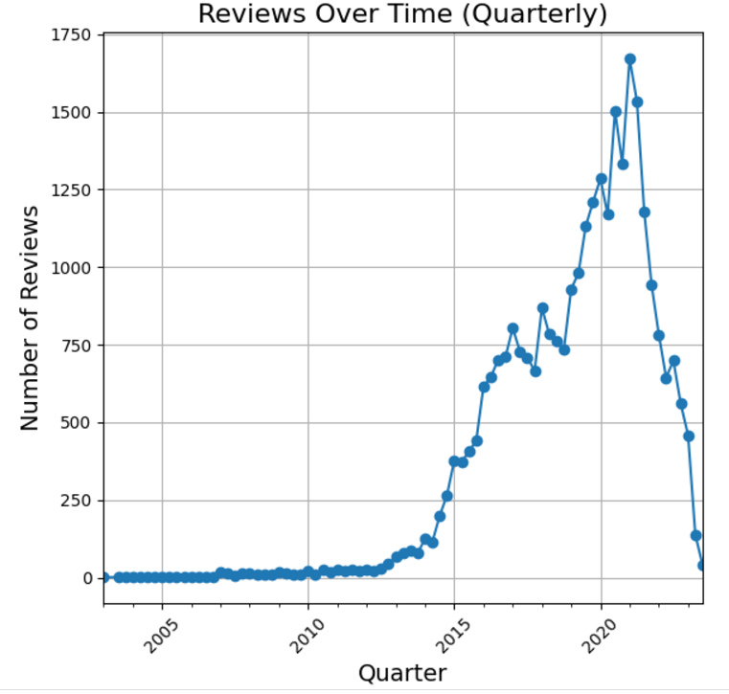
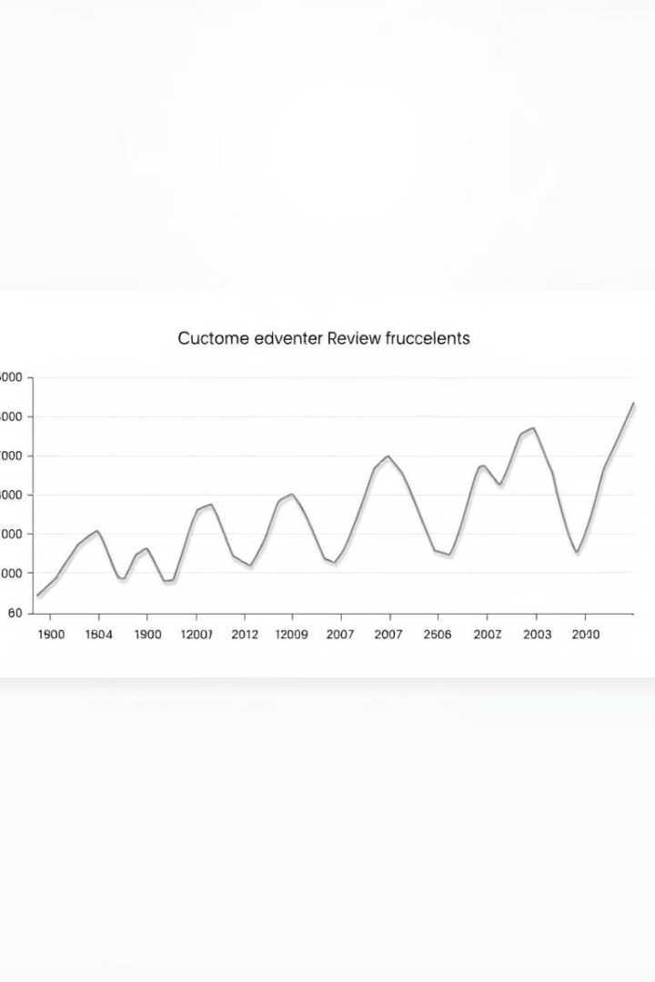
Review Volume Over Time
Reviews grew steadily from 2005 to 2015, surged sharply until peaking in 2019–2020, and declined rapidly post-2020, possibly due to market saturation, external disruptions, or reduced customer engagement.

Slide 13
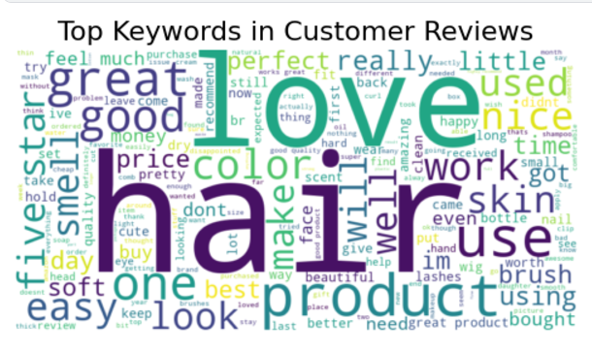
Top Keywords in Reviews

Slide 14




Keyword Analysis
Hair
Shampoo
Deo
Smell
High frequency keyword indicating focus on hair care products.
Frequent keyword, suggesting customer interest in shampoo quality and effectiveness.
Dominant keyword highlighting the importance of deodorant products.
High frequency keyword indicating customer's interest in fragrance preferences.
Other keywords such as "delivery," "quality," and "product" signify that customers comment on the overall shopping experience and product quality.
These insights inform product development and marketing strategies.

Slide 15

Natural Language Processing for Sentiment Analysis
Introduction to NLP sentiment analysis techniques.

Slide 16
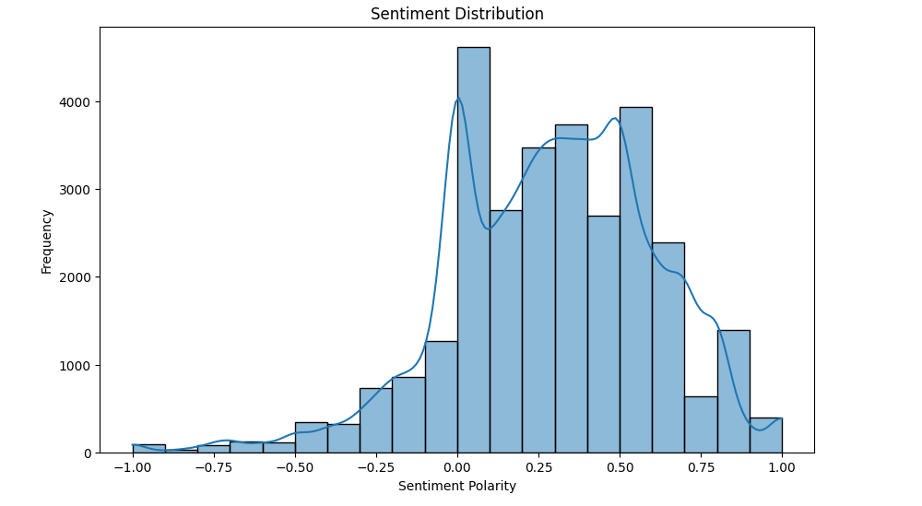
TextBlob Sentiment Analysis
Calculate polarity scores.
1
Polarity Scores
2
Categorization
Measure sentiment ranging from -1 (negative) to 1 (positive).
Group reviews based on sentiment polarity.
3
Correlation
Strong correlation between polarity scores and ratings.

Slide 17
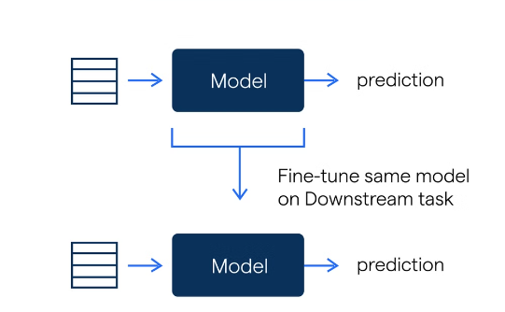
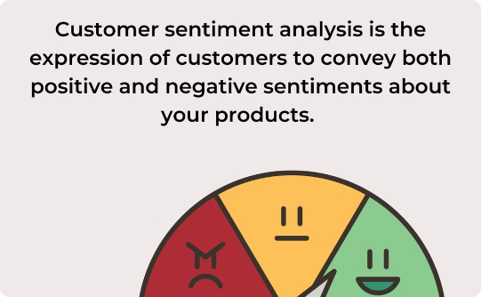
Sentiment Classification Using DistilBERT
Model Training
Sentiment Prediction
Fine-tuning DistilBERT for enhanced performance and precision.
High-accuracy sentiment classification leveraging optimized algorithms.

Slide 18
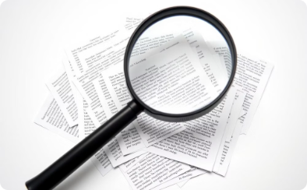



Pipeline Diagram DistilBERT
Text Preprocessing
Tokenization
Embedding
Fine-tuning
Initial text cleaning and preparation: removing punctuation and lowercasing.
Breaking preprocessed text into numerical tokens (words or sub-words).
Mapping tokens to numerical vectors that capture meaning and context.
Adjusting a pre-trained model's weights and parameters for sentiment classification.

Slide 19
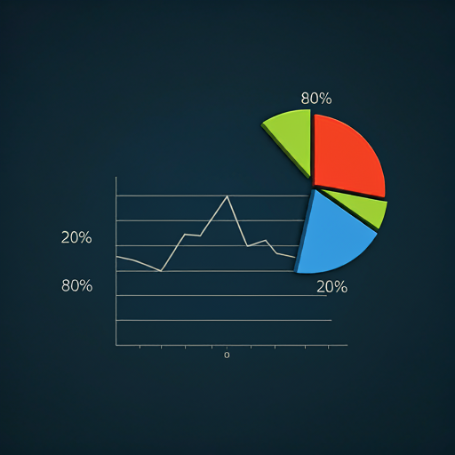
Training Details
Train the model using a balanced dataset.
Dataset Split
80% Train
20% Test
Hyperparameters
Learning Rate: 5e-5
Batch Size: 8
Metrics
Accuracy
F1-Score

Slide 20
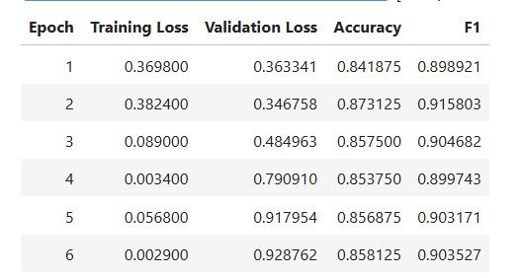
Evaluation and Results
Evaluate the model's performance on unseen data.
Evaluation
Measure the model's ability to generalize to new data.
Metrics
Assess accuracy and F1-score on the test dataset.
Results
Analyze the performance of the fine-tuned DistilBERT model.

Slide 21

Performance Metrics: Accuracy:
0.86
Accuracy
Accuracy represents the percentage of correctly classified instances, indicating the model's overall performance.

Slide 22
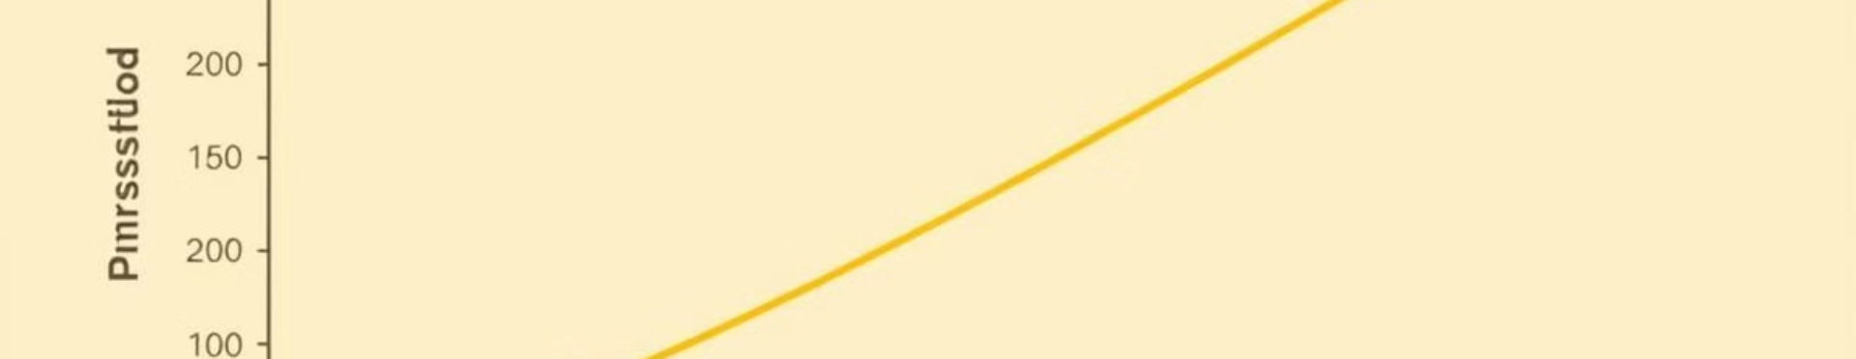
Performance Metrics: F1 Score:
0.90
The F1 score measures the model's ability to balance precision and recall, providing a comprehensive evaluation of its accuracy.

Slide 23

Benefits of Fine-Tuning DistilBERT
Improve the model's accuracy and domain-specific knowledge.
Enhanced Accuracy
Domain Expertise
Efficient Training
Achieve higher accuracy in sentiment classification tasks.
Adapt the model to specific domains and language patterns.
Train the model faster compared to training from scratch.

Slide 24
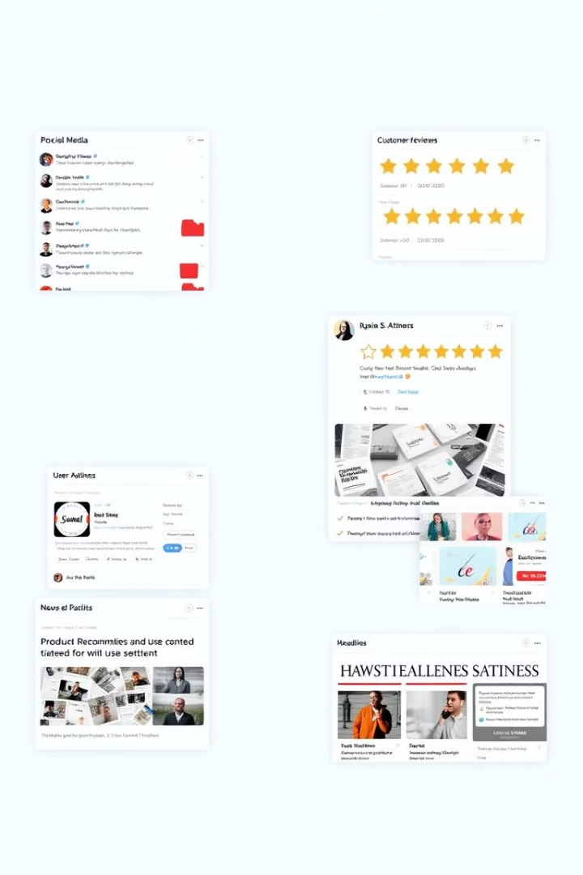




Applications of Sentiment Analysis
Utilize sentiment analysis in various fields.
Customer Experience
Product Development
Identifying and resolving pain points
Prioritizing features that resonate with customers
News Sentiment Analysis
Product Recommendation Systems
Understand public sentiment towards current events.
Personalize product recommendations based on user preferences.

Slide 25

Topic Modelling: LDA and BERTopic

Slide 26

What is Topic Modelling?
1
Uncovering Themes
2
Discovering Patterns
3
Applications
Topic modelling algorithms identify the latent topical themes present in a corpus of text data.
By analyzing word co-occurrences, topic modelling reveals the underlying structure and relationships within the data.
Topic modelling has diverse applications, such as text summarization, recommendation systems, and market research.

Slide 27
Latent Dirichlet Allocation (LDA)
Overview
Process
Output
LDA is a generative probabilistic model that represents documents as a mixture of topics, where each topic is characterized by a distribution over words.
LDA assumes that each document exhibits multiple topics, and each word in the document is assigned to one of these topics.
LDA outputs the topic distributions for each document and the word distributions for each topic, providing insights into the thematic structure of the corpus.

Slide 28
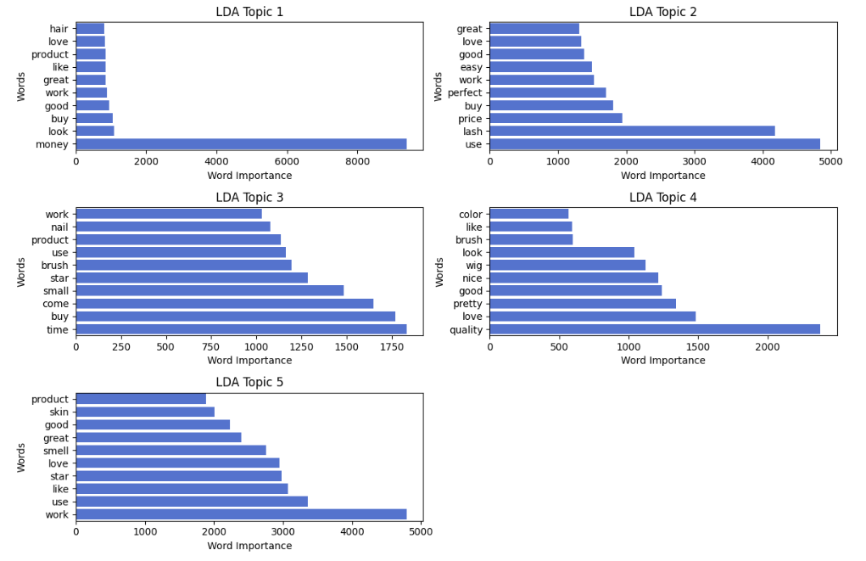
Latent Dirichlet Allocation Output

Slide 29
Insights
Topic | Top Words | Theme | Insights
Topic 1 | hair, love, product, like, great, work, good, buy, look, money | Hair care and affordability | Focuses on hair care products with discussions around cost ("money") and satisfaction ("love", "great")
Topic 2 | great, love, good, easy, work, perfect, buy, price, perfume, use | Cosmetic products (e.g., perfume) | Highlights product usability ("easy", "perfect") and cost-effectiveness ("price", "buy")
Topic 3 | work, nail, product, use, brush, star, small, come, buy, time | Nail care tools/products | Emphasizes tools like brushes and discussions on efficiency ("time", "use")
Topic 4 | color, like, brush, look, wig, nice, good, pretty, love, quality | Aesthetic preferences | Relates to appearance-focused products ("wig", "color") with positive sentiment ("nice", "quality")
Topic 5 | product, skin, good, great, smell, love, star, like, use, work | Skincare products(e.g., deo) | Skincare discussions emphasize fragrance ("smell") and quality ("good", "love")

Slide 30

Introducing BERTopic
1
BERT-based Embeddings
2
Dynamic Topic Extraction
3
Improved Interpretability
BERTopic utilizes BERT, a powerful language model, to generate rich text embeddings that capture semantic relationships.
The algorithm dynamically identifies relevant topics based on the input data, without requiring a predefined number of topics.
BERTopic provides more interpretable topics by considering contextual information and semantic associations.

Slide 31
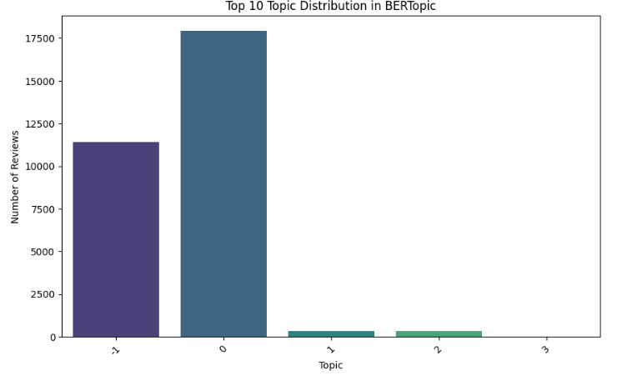

Slide 32
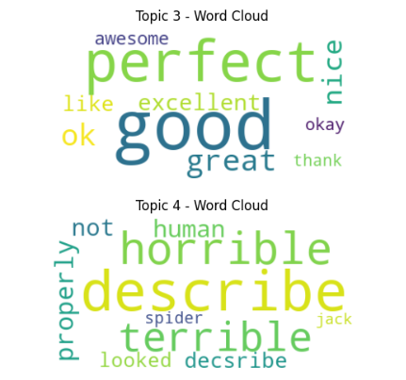
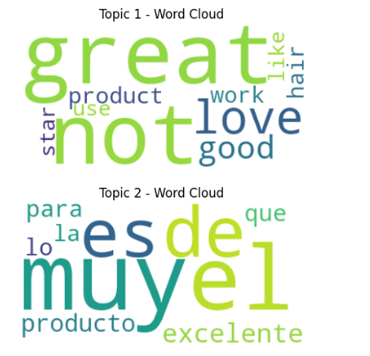
Visualizing Topics with Word Clouds for BerTopic

Slide 33
Insights of BerTopic
Topic | Top Words | Theme | Insights
Topic 1 | great, not, love, good, product, like, hair, star, work | General Product Feedback | The topic is dominated by positive feedback with words like "great", "love", and "good".
Topic 2 | es, de, muy, el, producto, excelente, para, que, lo | Spanish Feedback on Products | Feedback in Spanish focusing on excellence ("excelente", "muy bueno"), indicating a Spanish-speaking customer base.
Topic 3 | perfect, good, great, awesome, excellent, nice, okay, thank | Praise and Gratitude | Highly positive sentiment with emphasis on product quality ("perfect", "excellent", "awesome", "thank")
Topic 4 | horrible, describe, terrible, properly, not, human, jack, spider, looked | Negative Feedback/Complaints | Highlights dissatisfaction with strong negative words ("horrible", "terrible", "not") and specific issues ("describe", "properly")

Slide 34

Unmasking Customer Sentiment: Emotional Insights from Reviews

Slide 35
The Goal: Delving Deeper than Ratings
Beyond the Stars
Unveiling True Sentiment
While ratings are helpful, they only offer a superficial view. We want to capture the "why" behind the rating.
By analyzing emotions like joy, anger, or sadness, we gain a richer understanding of the customer experience.

Slide 36
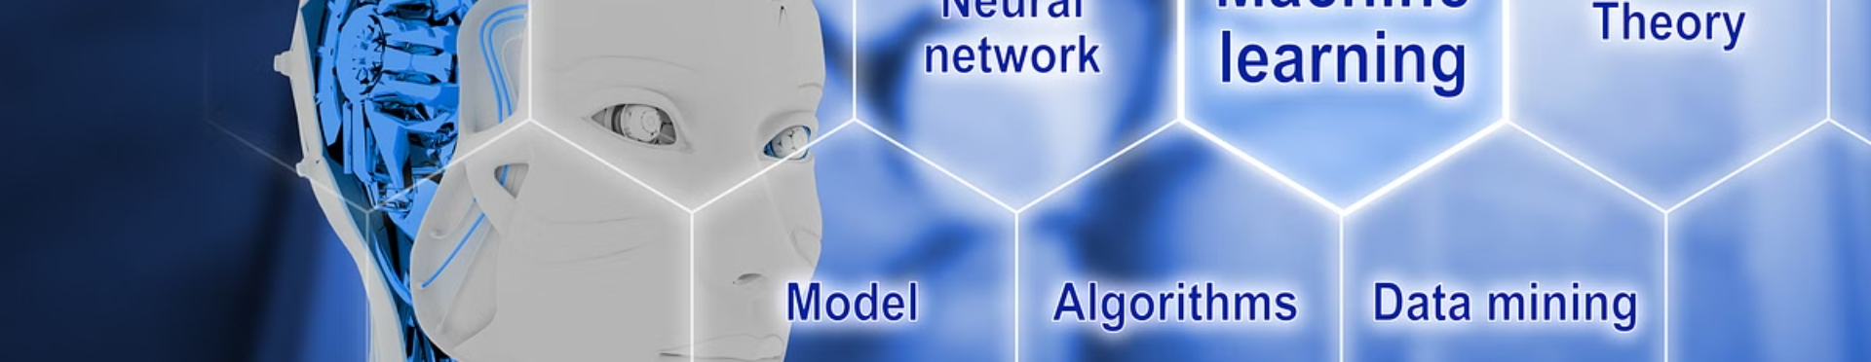
Leveraging the Power of AI: Our Model
1
Deep Learning
2
j-hartmann/emotion-english-distilroberta-base
We've chosen a pre-trained model specifically designed for emotion recognition in English text.
This model uses a deep learning architecture called RoBERTa, fine-tuned for emotional analysis.

Slide 37

Bridging the Gap: Aligning Emotions with Ratings
Model Calibration
Threshold-Based Adjustments
We've developed a logic to bridge the gap between model-predicted emotions and the rating score.
For example, reviews with ratings ≤ 2 are likely to express anger or sadness, while ratings ≥ 4 suggest joy or excitement

Slide 38
Performance Metrics: Accuracy:
0.95
Accuracy
Accuracy represents the percentage of correctly classified instances, indicating the model's overall performance.

Slide 39
Performance Metrics: F1 Score:
0.92
The F1 score measures the model's ability to balance precision and recall, providing a comprehensive evaluation of its accuracy.

Slide 40

Key Applications of Sentiment and Emotion Detection
Enhance Product Design
Leverage emotion and sentiment data to improve product functionality and user experience.
Personalize Interactions
Tailor experiences to individual user preferences and emotional needs.
Improve Customer Engagement
Utilize sentiment and emotion driven marketing and product strategies to build stronger brand value
Optimize Support Solutions
Implement intelligent systems to provide empathetic and responsive customer support.

Slide 41

The Future of Customer Insights

Slide 42

Integrate Feedback Loops
Collect Data
Deliver Insights
Continuously gather customer feedback, reviews, and interactions across all touchpoints.
Provide up-to-date, actionable intelligence to guide business decisions in real-time.
1
2
3
Analyze and Update
Feed new data into machine learning models to enhance accuracy and relevance.

Slide 43
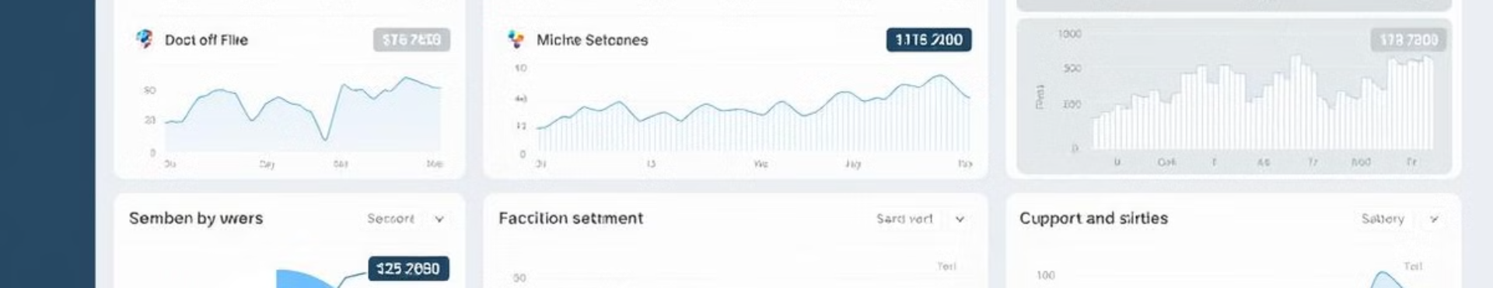



Real-Time Analysis
Sentiment Tracking
Emotion Detection
Actionable Insights
Capture customer sentiment quickly across all digital channels.
Utilize advanced AI to identify customer emotions and respond accordingly.
Deliver immediate insights to inform business strategies and customer experiences.

Slide 44
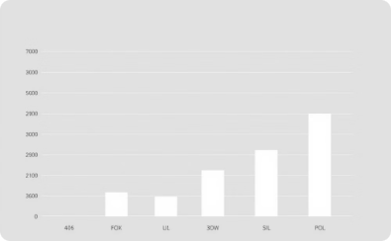
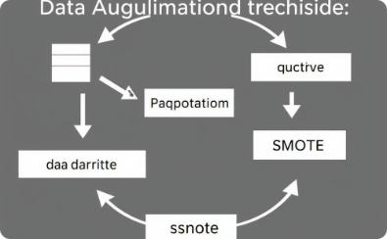
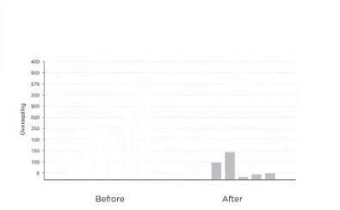
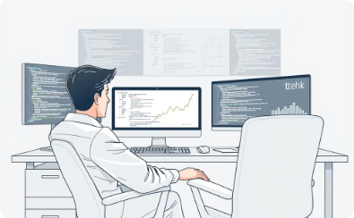
Challenges
Integration with multiple libraries version
Computational Constraints for Transformer Fine- Tuning
Interpretability and Model Fine-Tuning
Preprocessing Textual Data
Transformer models often act as "black boxes," making it challenging to interpret how predictions are made.
Customer reviews often contain noise such as typos, slang, emojis, and inconsistent formatting, making it challenging to preprocess the data effectively.
Sklearn and numpy version issues compatibility issue
Torch and numpy version compatibility issues
Fine-tuning transformer models like DistilBERT and RoBERTa required significant computational resources, especially with a dataset of ~30,000 reviews.

Slide 45

LIVE DEMO

